Slide 1

Immigration AI Advisor
Team: Borderless.AI Sprint 2 Presentation
Notes:
Miles

Slide 2

Agenda
Team Member Roles and Responsibilities
Improvements
Project Description
Team Working Agreement
Project Schedule
Personas
MVP
Technologies
Algorithms
Diagrams
Sprint 1 Recap
Product Backlog
Sprint 2 Backlog
Metrics
Retrospective
Sprint 3 Planning and Commitment
Project Demo
Github link
Live Demo
Notes:
Miles

Slide 3
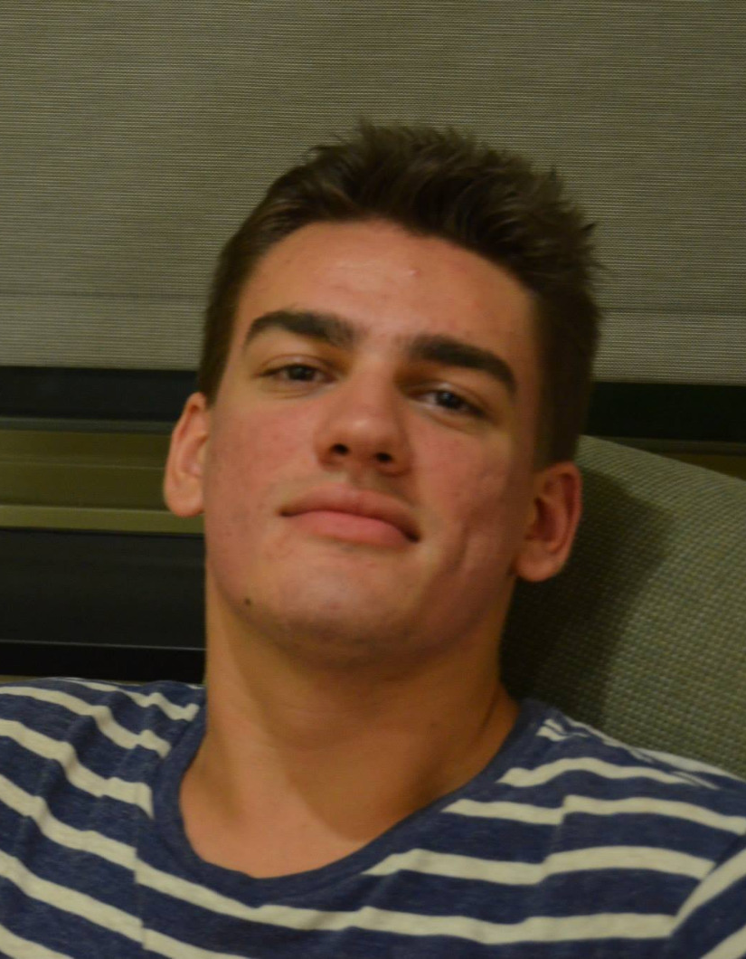
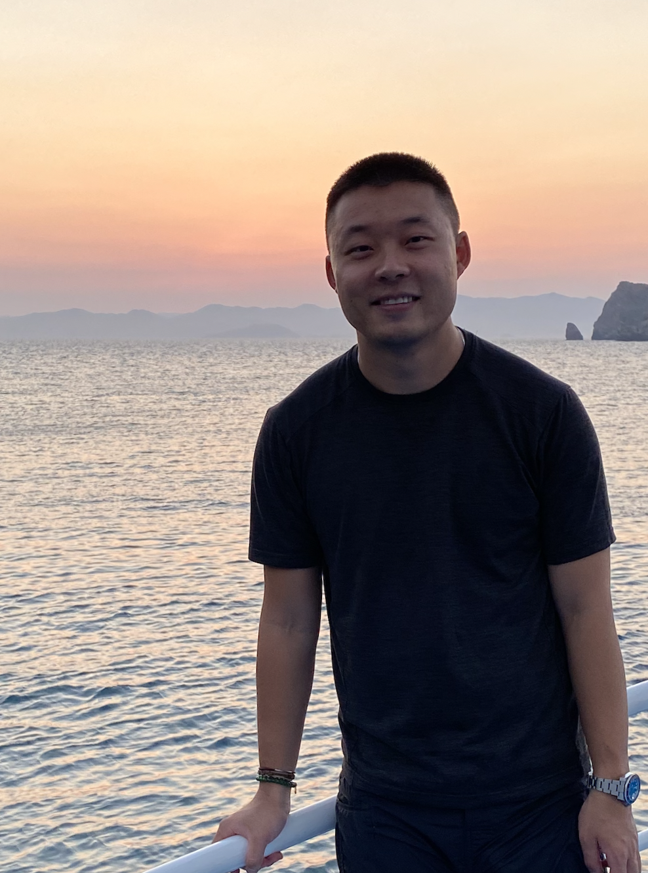
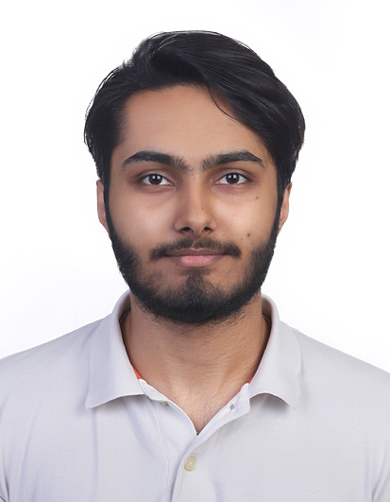


Team Member Roles and Responsibilities
Matt Borkowski
Developer
SCRUM Master
Miles ZhengFerrari
Developer
Team Leader
Nuvorish Paul
Developer
Raj Rahul Parekh
Developer
Santhosh Charudatta
Developer
All team members collaborate as developers, contributing to coding, testing, and feature development.
Notes:
Matt

Slide 4
Improvements
Architecture Diagram
ER Diagram
Project Backlog
Notes:
Raj

Slide 5
Project Description
Project Name: Immigration AI Advisor
Team: Borderless.AI
Project Description:
Immigration AI Advisor is a AI-based application designed to assist international students with immigration-related queries by reading documents (I-20, I-94) and providing personalized advice based on immigration rules and policies.
Benefit Outcomes:
Faster, more accurate immigration advice for international students.
Reduced burden on international student offices with limited resources.
Improved efficiency in managing immigration-related queries within budget constraints.
Github Link:https://github.com/htmw/2024F-borderless.ai/wiki
Notes:
Nuvorish

Slide 6
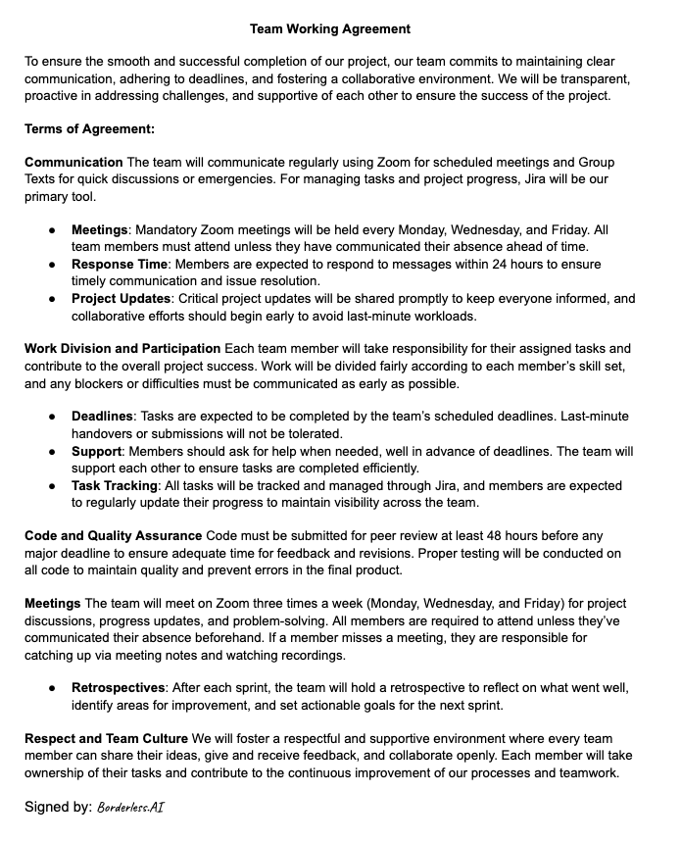
Team Working Agreement
Notes:
Miles

Slide 7
Project Schedule
Sprint 0: Understanding the Project (Pre-Development Phase)
Goal: Gather requirements, define project scope, and identify key user needs.
Activities:
Understand the scope of immigration document handling (I-20, I-94).
Research relevant immigration rules and policies.
Define key features for the Immigration AI Advisor (PDF upload, document parsing, personalized advice).
Set up the development environment and select tech stack (Python, Flask, AI framework).
Initial team roles assignment.
Notes:
Nuvorish

Slide 8
Project Schedule
Sprint 1: Basic PDF Upload & Parsing
Goal: Build and demonstrate the basic functionality of the Immigration AI Advisor.
Tasks:
Implement PDF upload functionality via the web UI.
Develop code for reading and extracting basic information from I-20 PDFs (e.g., Name, DoB).
Establish Flask as the backend for handling requests.
Test and verify that the I-20 upload and parsing process is functional.
Demo the working upload and basic data extraction.
Notes:
Nuvorish

Slide 9
Project Schedule
Sprint 2: AI Component and Chat Box Front End
Goal: Introduce basic AI-driven advice.
Tasks:
Implement basic AI functionality to begin providing personalized advice
Ensure the system is flexible enough to handle more complex parsing as needed.
Front End UI and Chat Box functionality
Notes:
Nuvorish

Slide 10
Project Schedule
Sprint 3: AI Component Enhancement
Goal: Improve the AI’s capability to provide more complex immigration advice.
Tasks:
Refine the AI logic to handle more nuanced queries based on immigration policies.
Add more advanced decision-making capabilities to the AI component.
Enhance the AI model's ability to analyze and cross-reference multiple document types.
Test the AI’s performance and ensure it scales well with increased complexity.
Prepare the Immigration AI Advisor for final testing and potential deployment.
Notes:
Nuvorish

Slide 11

Personas
Name: Sarah Johnson
Age: 35
Role: International Student Adviser
Background:
Sarah has been an adviser for 8 years, handling hundreds of students each semester. She’s responsible for guiding them through immigration processes, ensuring compliance with visa regulations, and managing I-20 and I-94 forms.
Challenges:
Overwhelmed by repetitive tasks (e.g., checking I-20, I-94 documents). Struggles to keep up with changing immigration rules. Limited time for personalized student interactions due to workload.
Goals:
Automate routine tasks to reduce workload. Improve accuracy and efficiency in advising. Free up time for more complex student cases.
How Immigration AI Advisor Helps:
Automates document review (I-20, I-94).
Provides preliminary, personalized immigration advice.
Reduces manual workload, enabling Sarah to focus on complex cases.
Notes:
Santhosh

Slide 12

Personas
Name: Aakken Lee
Age: 22
Role: International Student, 3rd-year undergraduate
Background:
Aakken is studying Computer Science and is on an F-1 visa. He regularly deals with immigration paperwork like I-20s and I-94s, and needs to stay compliant with visa regulations to maintain his legal status in the U.S.
Challenges:
Needs quick, accurate advice on maintaining visa status. Often faces delays due to overburdened advisers. Uncertainty about document requirements or policy changes causes stress.
Goals:
Access immediate immigration information and advice. Avoid potential issues with immigration status.
How Immigration AI Advisor Helps:
Provides instant, accurate responses to common immigration queries.
Offers clear explanations of I-20 and I-94 documents.
Reduces reliance on advice availability for basic information.
Notes:
Santhosh

Slide 13

Personas
Name: Dr. Maria Rodriguez
Age: 50
Role: VP of Office of Global Services
Background:
Dr. Rodriguez’s role focuses on ensuring compliance with immigration regulations while enhancing student support and satisfaction. She’s responsible for strategic planning, resource allocation, and policy implementation.
Challenges:
Ensuring the institution stays compliant with evolving immigration laws. Balancing limited resources with the growing needs of international students.
Goals:
Improve efficiency to better serve students. Use data and automation to ensure compliance with immigration rules while respect the limited budget.
How Immigration AI Advisor Helps:
Streamlines immigration document processing, freeing up adviser resources.
Enhances support for international students, improving satisfaction and retention.
Notes:
Santhosh

Slide 14
MVP
Description:
The MVP of the Immigration AI Advisor focuses on delivering essential functionality to assist international students with their immigration-related needs. The MVP allows users to upload their I-20 document, and the system extracts key information such as their Name and Date of Birth. This basic document parsing provides immediate value by automating a critical task, helping students quickly access and verify important information from their immigration paperwork.
Key Features of the MVP:
PDF Upload: Users can upload an I-20 form through a web interface.
Data Extraction: The system automatically extracts and displays basic information (e.g., Name, Date of Birth).
Usability: Users can interact with the system, receive valuable information instantly, and ensure their immigration documents are processed accurately.
Value to Users:
The MVP solves a practical problem for students by saving time and reducing the complexity of manually reading their immigration documents. It provides immediate utility while laying the groundwork for future enhancements, such as more detailed document parsing and AI-based immigration advice.
Notes:
Raj

Slide 15
Technologies
Languages & Frameworks:
Python, Flask, FastAPI, Pytest, ReactJS, HTML, CSS
Artificial Intelligence:
TensorFlow, PyTorch, Chat GPT4o mini, BART, Claude
Any additional technology we may discover and add as we move on to each sprints.
Notes:
Matt

Slide 16
Algorithms
Regular Expressions/Pattern Matching
To recognize structure of, and extract information from, I-20 formatted forms
AI Large Language Models
LLM’s (Large Language Models), minimally trained language models, to provide the basis of a custom-trained, immigration-oriented “knowledge base”
TensorFlow/ PyTorch:
Might be used for statistical/quantitative analysis and transformation, in order to augment LLMs’ capabilities
Notes:
Matt

Slide 17
Diagrams
Architecture Diagrams
Context Diagram
ER Diagram
Sequence Diagram
State Diagrams
Notes:
Santosh

Slide 18
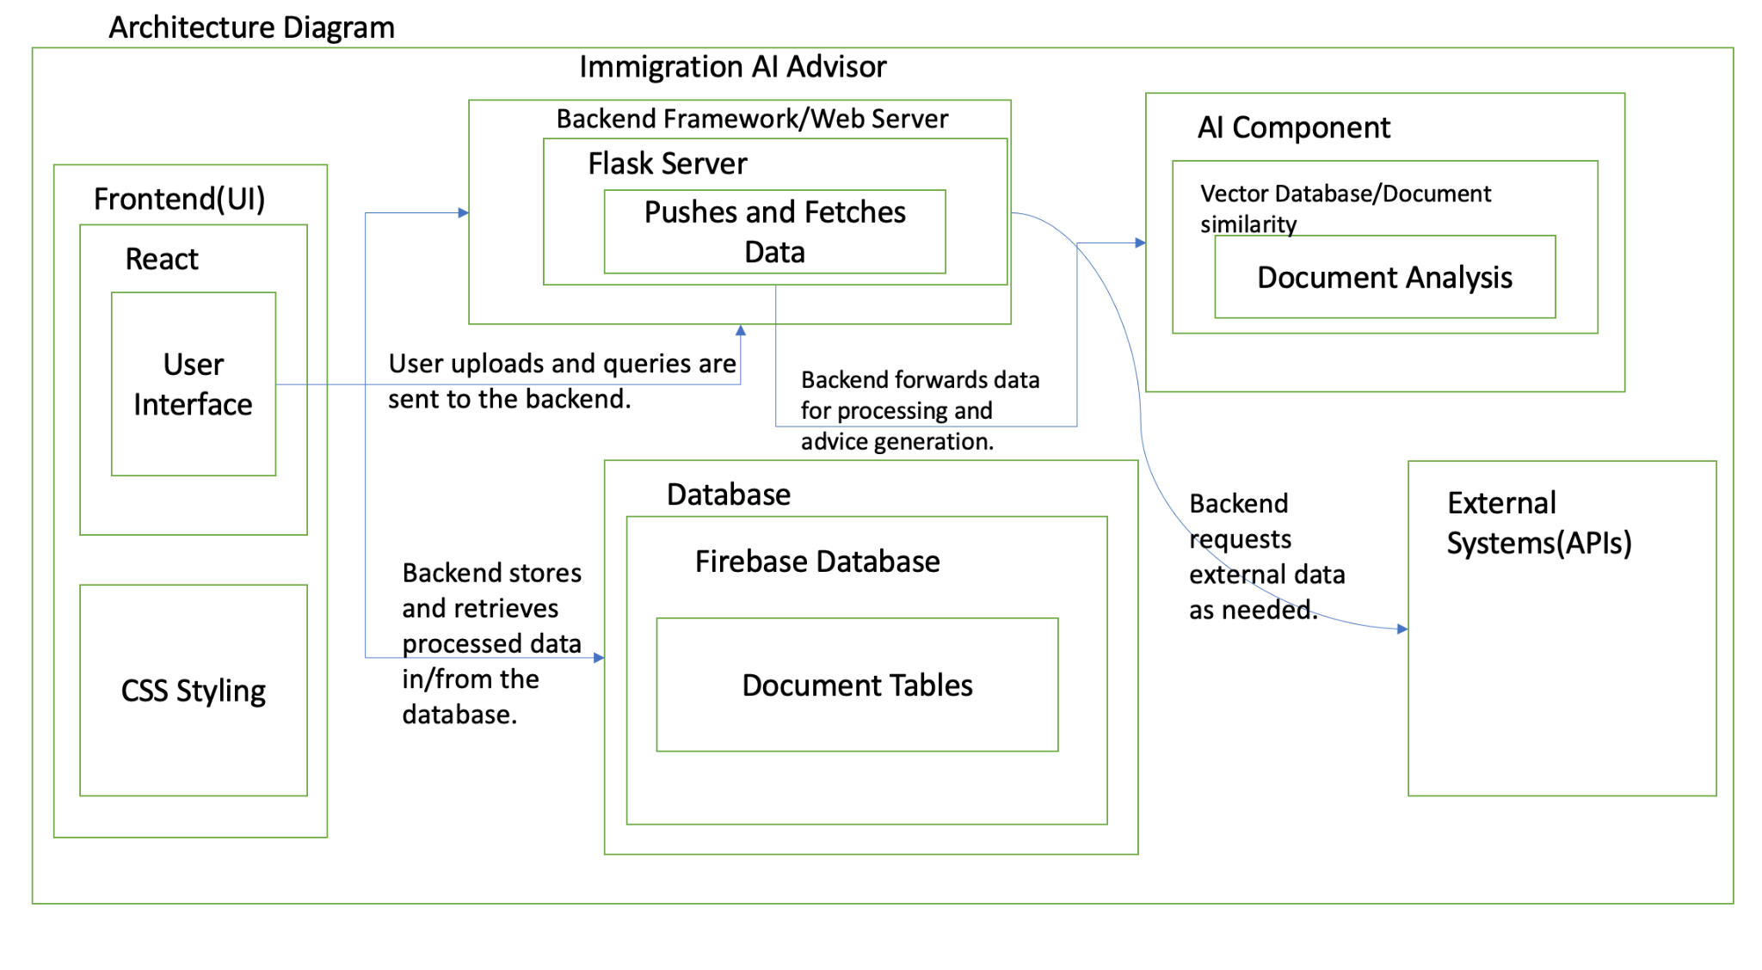
Architecture Diagram
Notes:
Santosh

Slide 19
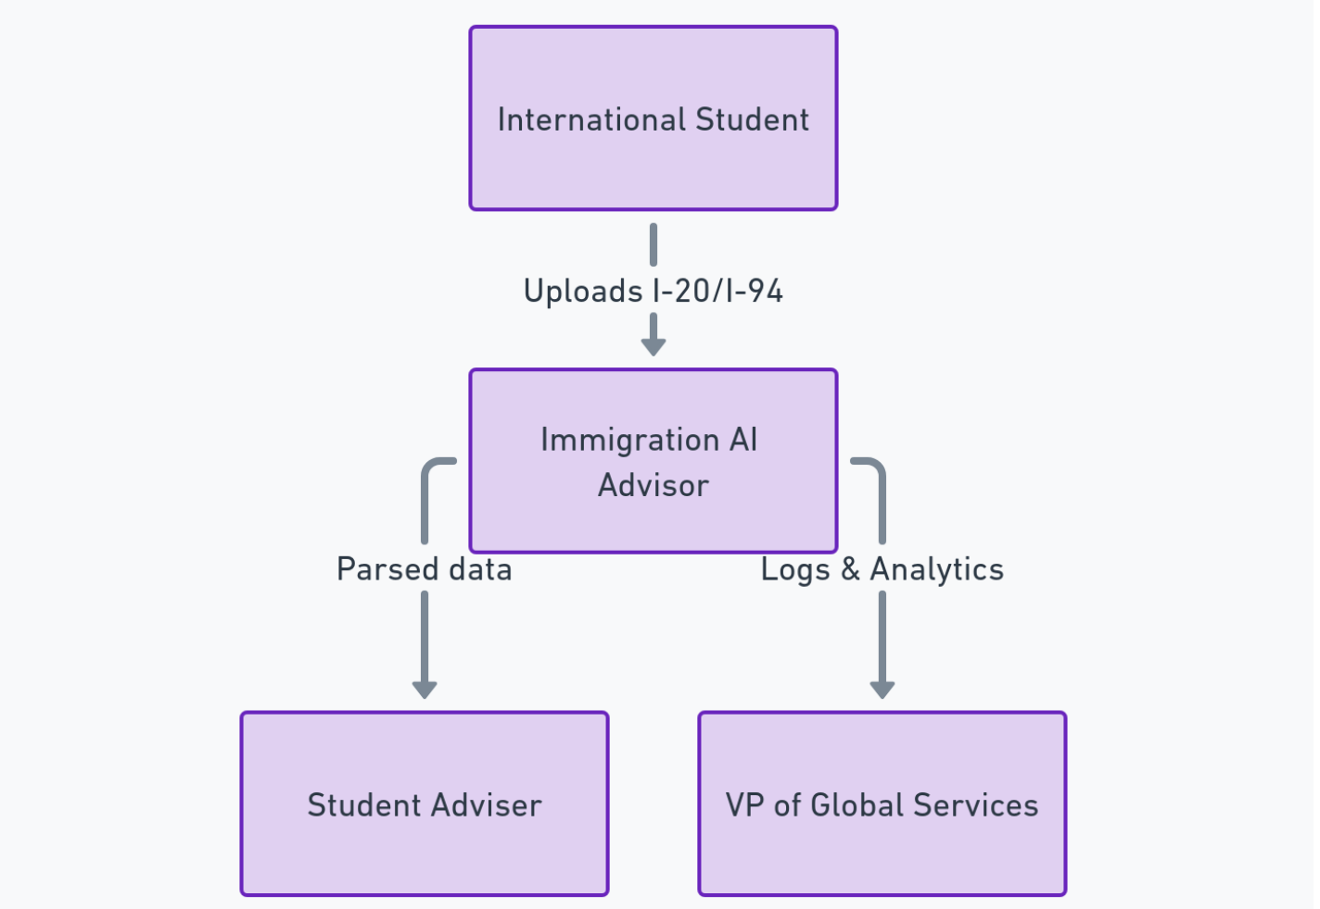
Context Diagram
Notes:
Santhosh

Slide 20
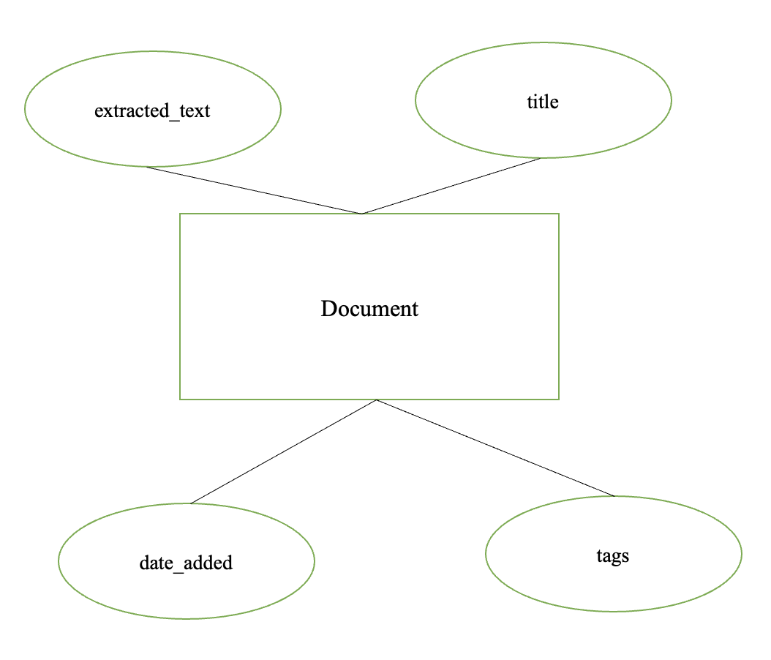
ER Diagram (Entity-Relationship Diagram)
Notes:
Raj

Slide 21
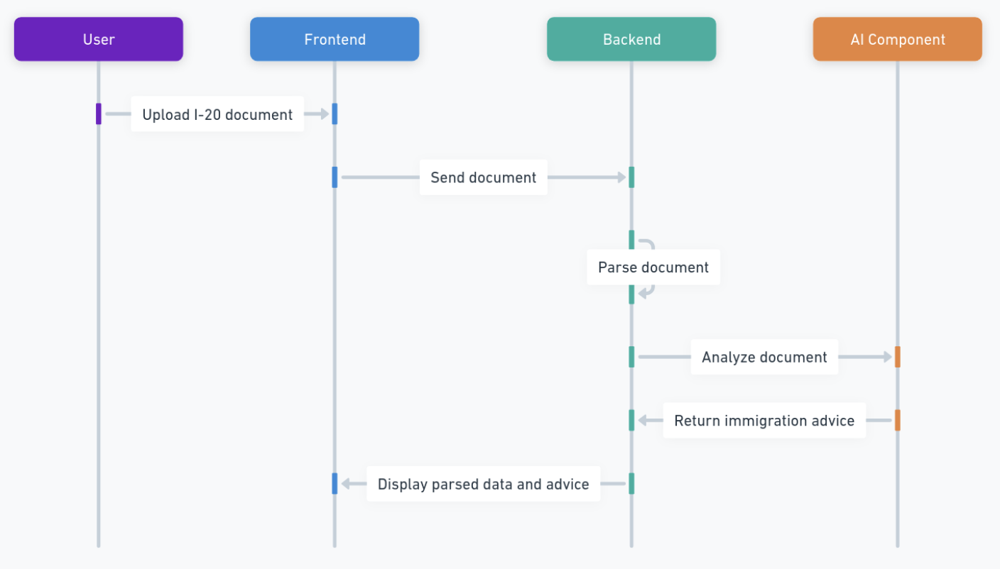
Sequence Diagram
Notes:
Nuvorish

Slide 22
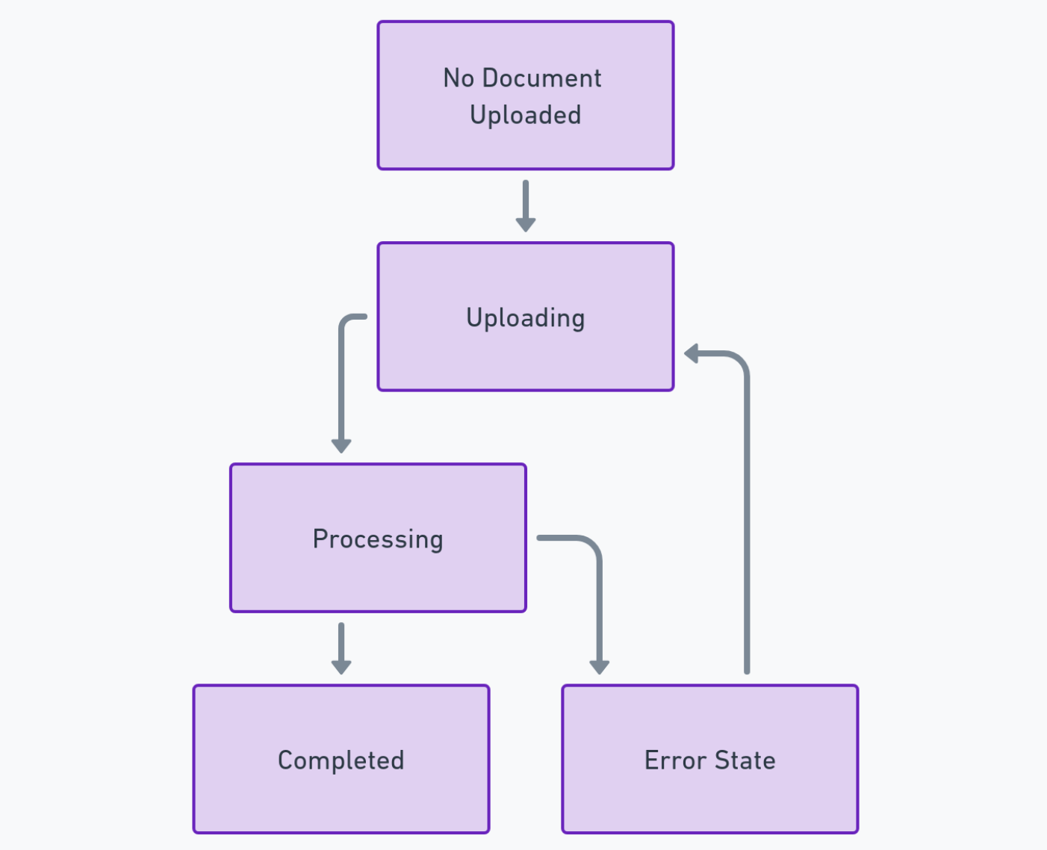
State Diagram
Notes:
Nuvorish

Slide 23
Sprint 1 Recap
Sprint Goals:
Objective: Build and demonstrate the basic functionality of the Immigration AI Advisor.
Enable users to upload I-20 PDFs via the web UI.
Extract key information (e.g., Name, Date of Birth) from I-20 PDFs.
Set up Flask as the backend to handle requests and processing.
Key Accomplishments:
PDF Upload Functionality: Successfully developed and tested a user-friendly interface for document uploads.
Basic Information Parsing: Implemented code to extract Name and Date of Birth from I-20 PDFs accurately.
Backend Setup: Established Flask as the backend and created endpoints for handling uploads.
Testing and Validation: Ensured stability for invalid or corrupted file uploads.
Notes:
Matt

Slide 24
Project Backlog
Stories or Tasks for the Whole Project
Notes:
Santhosh

Slide 25
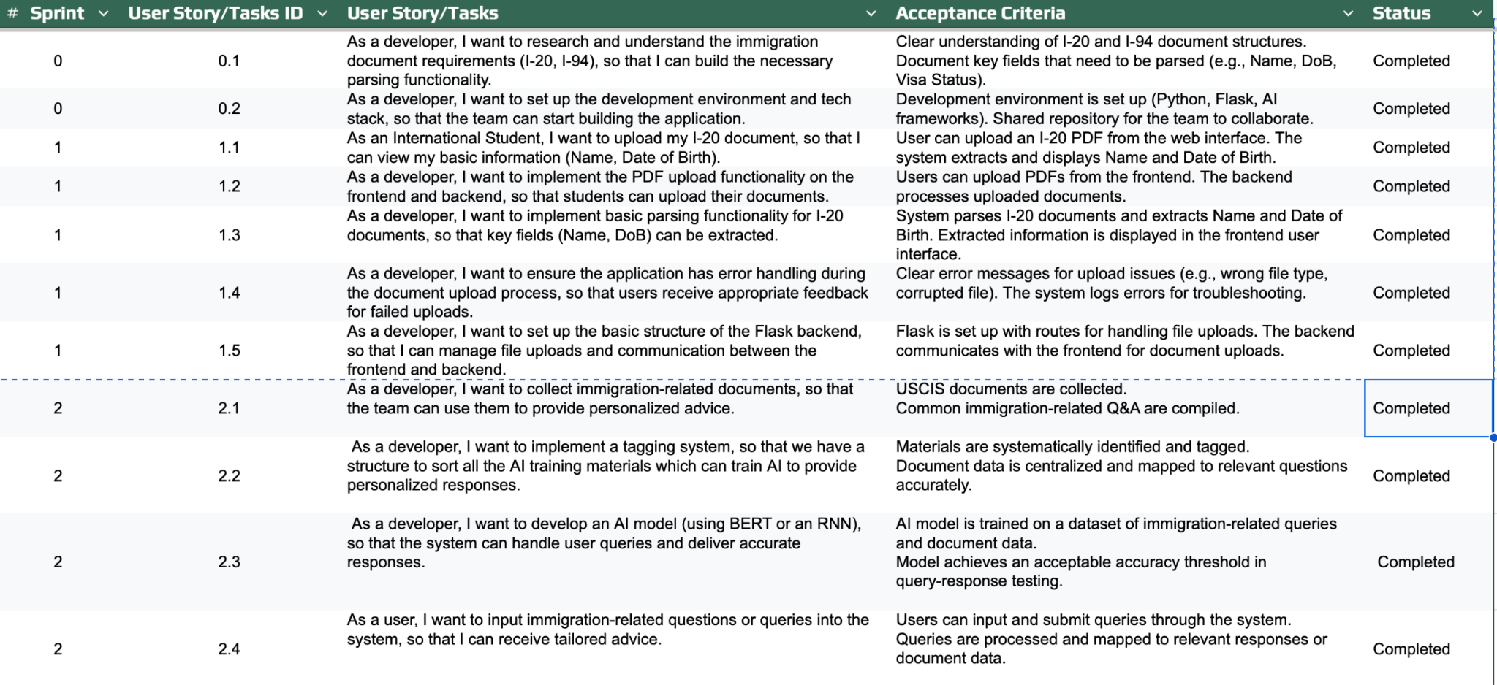
Notes:
Santhosh

Slide 26
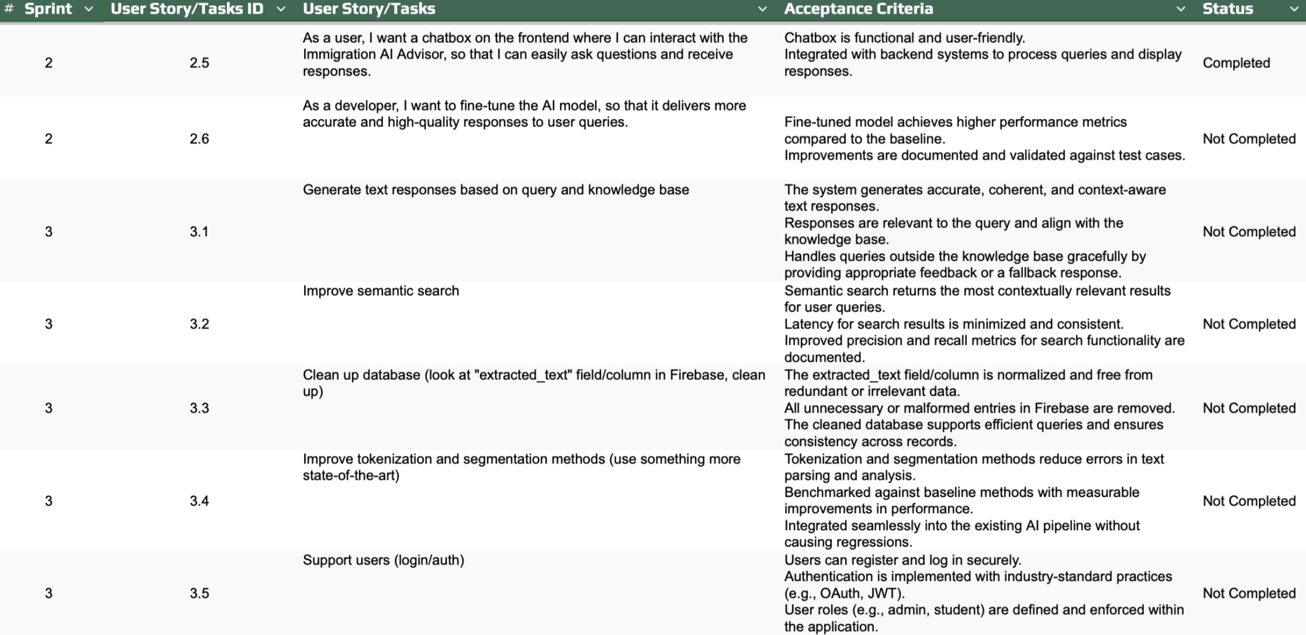

Slide 27
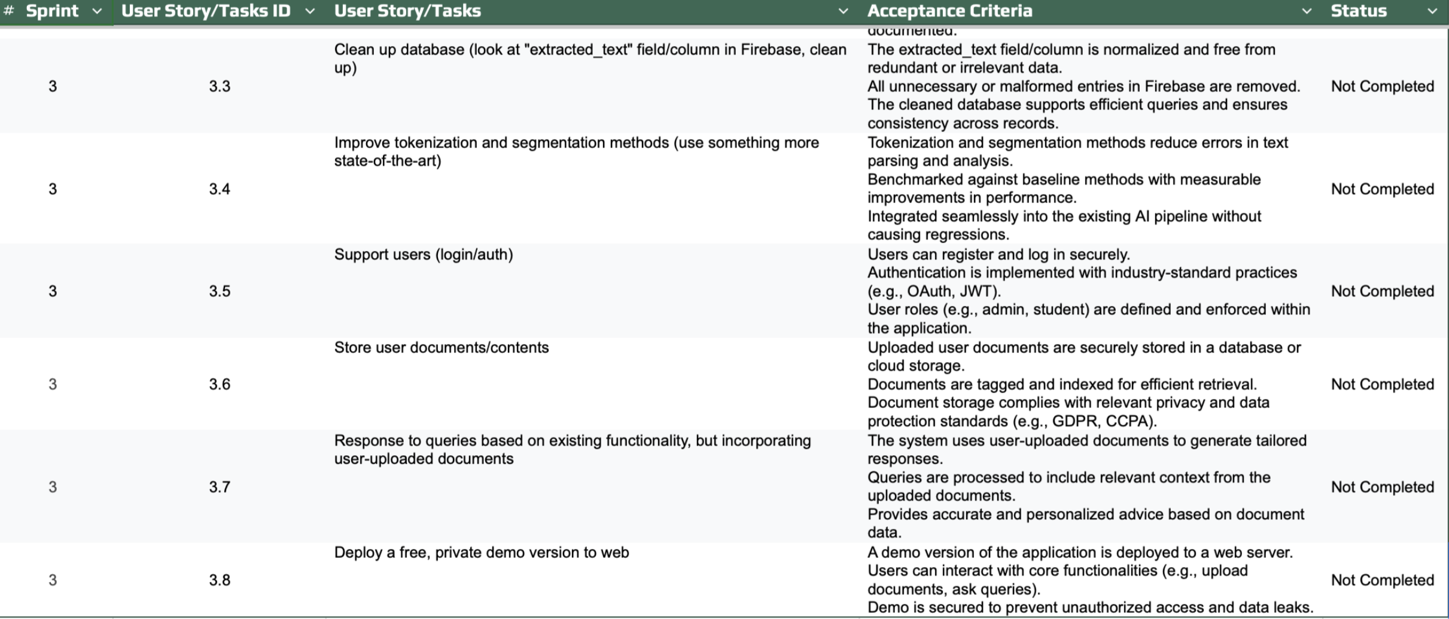
Notes:
Santhosh

Slide 28
Sprint 2 Backlog
Stories or Tasks committed for this Sprint
Task 2.1: As a developer, I want to collect immigration-related documents, so that the team can use them to provide personalized advice. Acceptance Criteria:
USCIS documents are collected.
Common immigration-related Q&A are compiled. Story Points: 4
Task 2.2: As a developer, I want to implement a tagging system, so that we have a structure to sort all the AI training materials which can train AI to provide personalized responses. Acceptance Criteria:
Materials are systematically identified and tagged.
Document data is centralized and mapped to relevant questions accurately. Story Points: 5
Notes:
Milles

Slide 29
Sprint 2 Backlog
Stories or Tasks committed for this Sprint
Task 2.3: As a developer, I want to develop an AI model (using BERT or an RNN), so that the system can handle user queries and deliver accurate responses. Acceptance Criteria:
AI model is trained on a dataset of immigration-related queries and document data.
Model achieves an acceptable accuracy threshold in query-response testing. Story Points: 15
User Story 2.4: As a user, I want to input immigration-related questions or queries into the system, so that I can receive tailored advice. Acceptance Criteria:
Users can input and submit queries through the system.
Queries are processed and mapped to relevant responses or document data. Story Points: 5
Notes:
Milles

Slide 30
Sprint 2 Backlog
Stories or Tasks committed for this Sprint
User Story 2.5: As a user, I want a chatbox on the frontend where I can interact with the Immigration AI Advisor, so that I can easily ask questions and receive responses. Acceptance Criteria:
Chatbox is functional and user-friendly.
Integrated with backend systems to process queries and display responses. Story Points: 7
Task 2.6: As a developer, I want to fine-tune the AI model, so that it delivers more accurate and high-quality responses to user queries. Acceptance Criteria:
Fine-tuned model achieves higher performance metrics compared to the baseline.
Improvements are documented and validated against test cases. Story Points: 10
Notes:
Milles

Slide 31
Sprint 2 Backlog
Test Cases
Task 2.1: As a developer, I want to collect immigration-related documents, so that the team can use them to provide personalized advice.
Check if USCIS documents are collected.
Check if Common immigration-related Q&A are compiled. Story Points: 4, TID: 2001
Task 2.2: As a developer, I want to implement a tagging system, so that we have a structure to sort all the AI training materials which can train AI to provide personalized responses.
Verify the Materials are systematically identified and tagged.
Verify if the Document data is centralized and mapped to relevant questions accurately. Story Points: 5, TID: 2002
Notes:
Santhosh

Slide 32
Sprint 2 Backlog
Test Cases
Task 2.3: As a developer, I want to develop an AI model (using BERT or an RNN in PyTorch or TensorFlow), so that the system can handle user queries and deliver accurate responses.
Ensure that the AI model is trained on a dataset of immigration-related queries and document data.
Verify if the Model achieves an acceptable accuracy threshold in query-response testing. Story Points: 15, TID: 2003
User Story 2.4: As a user, I want to input immigration-related questions or queries into the system, so that I can receive tailored advice.
Test if the Users can input and submit queries through the system.
Check if the Queries are processed and mapped to relevant responses or document data. Story Points: 5, TID: 2004
Notes:
Santhosh

Slide 33
Sprint 2 Backlog
Test Cases
User Story 2.5: As a user, I want a chatbox on the frontend where I can interact with the Immigration AI Advisor, so that I can easily ask questions and receive responses.
Test the Chatbox to verify that it is functional and user-friendly.
Check if it is integrated with backend systems to process queries and display responses. Story Points: 7, TID: 2005
Task 2.6: As a developer, I want to fine-tune the AI model, so that it delivers more accurate and high-quality responses to user queries.
Does the fine-tuned model achieve higher performance metrics compared to the baseline?
Are the improvements documented and validated against predefined test cases? Story Points: 10,TID: 2006
Notes:
Santhosh

Slide 34
Sprint 2 Backlog
Stories completed
Task 2.1: As a developer, I want to collect immigration-related documents, so that the team can use them to provide personalized advice. Acceptance Criteria:
USCIS documents are collected.
Common immigration-related Q&A are compiled. Story Points: 4, Status : Completed
Task 2.2: As a developer, I want to implement a tagging system, so that we have a structure to sort all the AI training materials which can train AI to provide personalized responses. Acceptance Criteria:
Materials are systematically identified and tagged.
Document data is centralized and mapped to relevant questions accurately. Story Points: 5, Status : Completed
Notes:
Santhosh

Slide 35
Sprint 2 Backlog
Stories completed
Task 2.3: As a developer, I want to develop an AI model (using BERT or an RNN), so that the system can handle user queries and deliver accurate responses. Acceptance Criteria:
AI model is trained on a dataset of immigration-related queries and document data.
Model achieves an acceptable accuracy threshold in query-response testing. Story Points: 15, Status : Completed
User Story 2.4: As a user, I want to input immigration-related questions or queries into the system, so that I can receive tailored advice. Acceptance Criteria:
Users can input and submit queries through the system.
Queries are processed and mapped to relevant responses or document data. Story Points: 5, Status : Completed
Notes:
Santhosh

Slide 36
Sprint 2 Backlog
Stories completed
User Story 2.5: As a user, I want a chatbox on the frontend where I can interact with the Immigration AI Advisor, so that I can easily ask questions and receive responses. Acceptance Criteria:
Chatbox is functional and user-friendly.
Integrated with backend systems to process queries and display responses. Story Points: 7, Status : Completed
Notes:
Santhosh

Slide 37
Sprint 2 Backlog Stories Not Completed
Task 2.6: As a developer, I want to fine-tune the AI model, so that it delivers more accurate and high-quality responses to user queries. Acceptance Criteria:
Fine-tuned model achieves higher performance metrics compared to the baseline.
Improvements are documented and validated against test cases. Story Points: 10, Status : Not-Completed
Total Story Points: 46 points
Total Completed Stories: 36 points
Total Stories not completed: 10 points
Notes:
Matt

Slide 38
Metrics
Team Velocity - Sprint 2
Details:
The team successfully completed 5 user stories, focusing on core functionalities such as collecting immigration-related documents, implementing a tagging system, developing an AI model, enabling user queries, and integrating a functional chatbox. These achievements significantly advanced the system's ability to provide personalized immigration advice. However, the task to fine-tune the AI model for improved accuracy remains incomplete.
The unfinished task involves fine-tuning the AI model to achieve higher performance metrics compared to the baseline and documenting improvements against test cases. This will be carried forward to the next sprint.
Story points are based on the complexity and effort required for each story, not the number of issues.
Total Story Points: 46
Completed Story Points: 36
Not Completed Story Points: 10
Notes:
Nuvorish

Slide 39
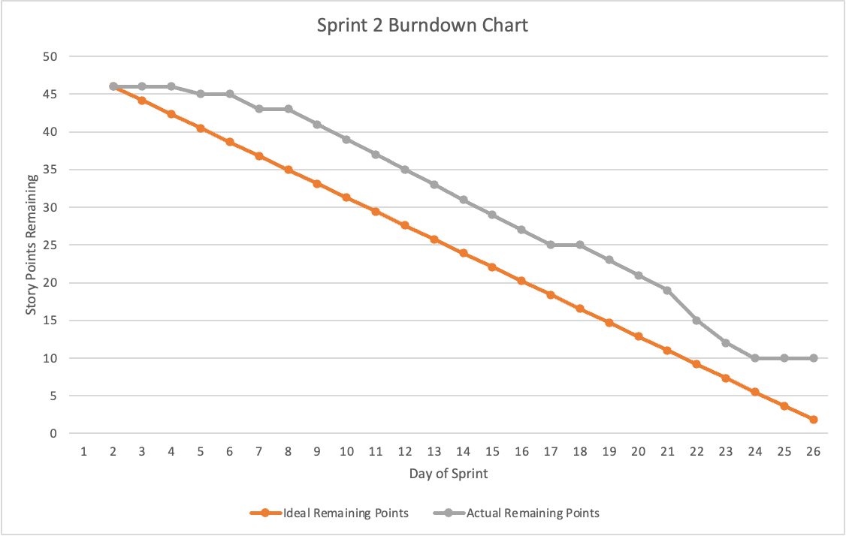
Metrics
Notes:
Nuvorish

Slide 40
Metrics
Completed/Committed Ratio:
36/46=78.28%
Notes:
Nuvorish

Slide 41
Retrospective
What Went Well?
Improved the MVP.
Improved the front-end design.
Implemented basic AI functionality.
Successfully collected required documents.
Followed Agile programming principles.
Completed most user stories.
What Can Be Improved?
Improve communication via WhatsApp.
Adhere to deadlines more strictly.
Update the team regularly on individual tasks.
Provide specific details on issues and challenges.
Increase transparency on work progress.
Avoid last-minute communication; encourage collaboration.
Actionable Items:
Respond promptly to WhatsApp messages ASAP when seen.
Collaborate more actively in the next sprint by forming subtext groups.
Complete all components 72 hours before deadlines.
Ensure three meetings per week, with one in-person meeting.
Attempt to conduct daily standups for progress tracking.
Notes:
Raj

Slide 42
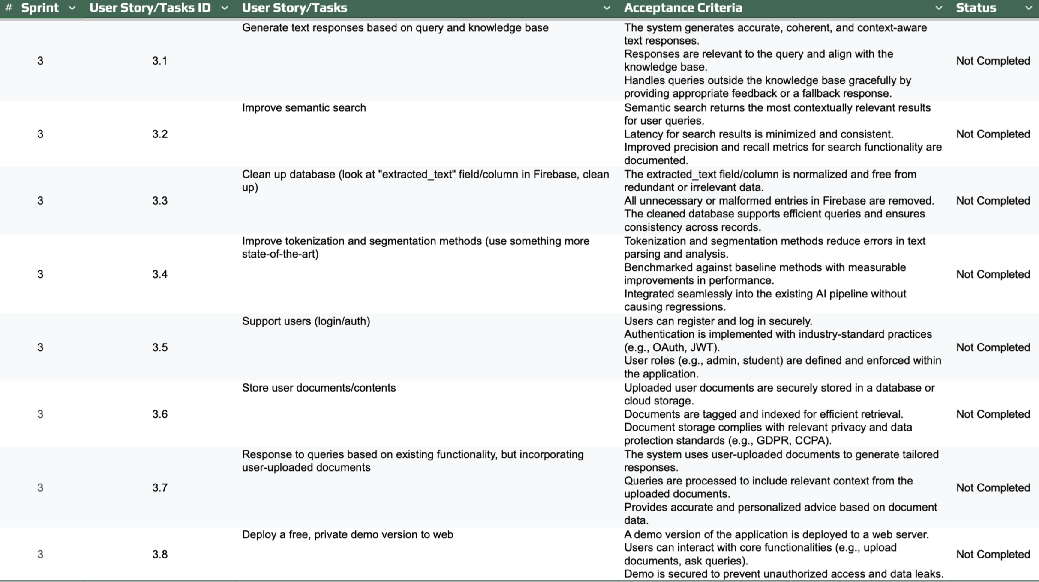
Sprint 3 Planning and Commitment
Notes:
Miles

Slide 43
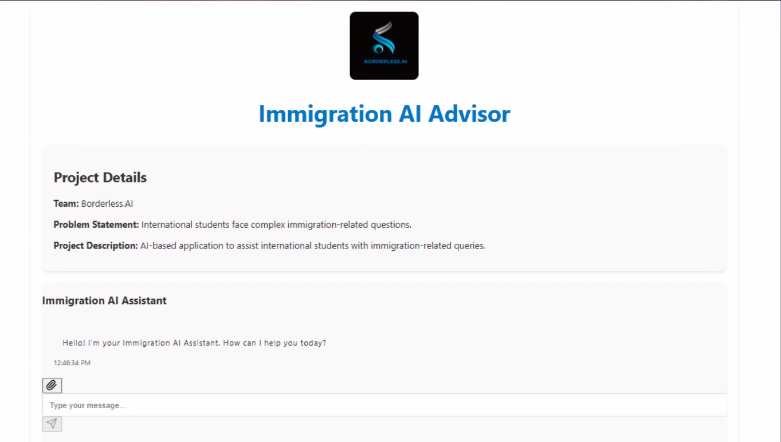
Project Demo
Notes:
Nuvorish

Slide 44
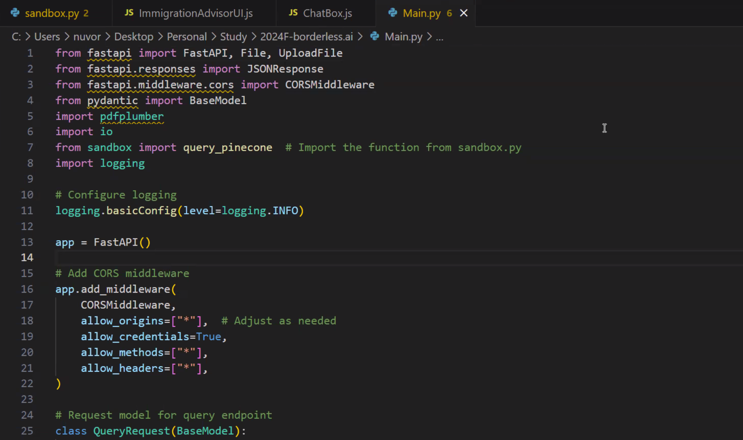
Project Demo
Notes:
Nuvorish

Slide 45
Github Link
https://github.com/htmw/2024F-borderless.ai/wiki
Notes:
Matt

Slide 46
Live Application Demo
Notes:
Nuvorish

Slide 47
THANK YOU!
Notes:
Nuvorish

